Slide 1




Copyright and consumption

Slide 2


AI and Accessibility:
the Good,
the Bad,
and the Bollocks
Léonie Watson

Slide 3

Never mind

Slide 4
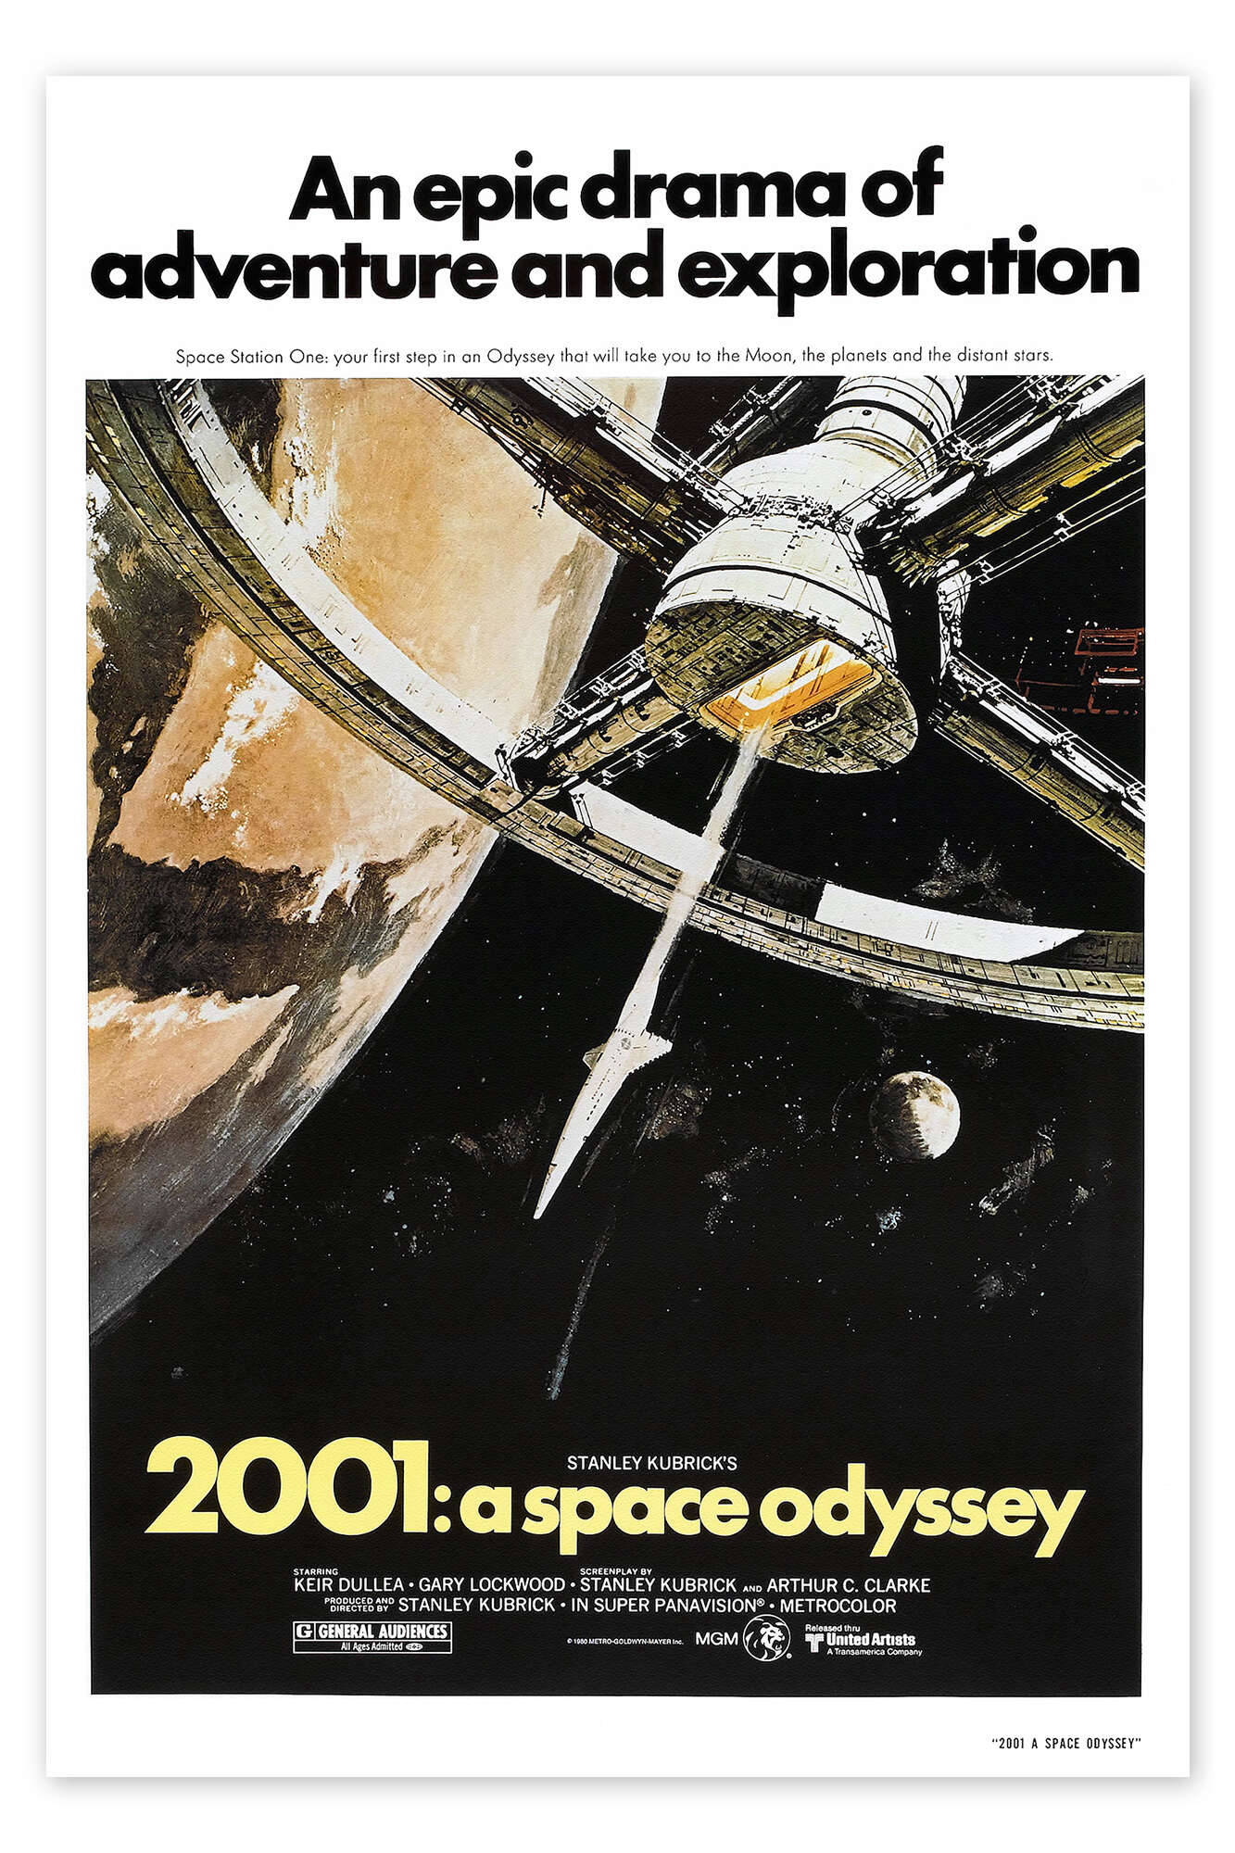

General AI

Slide 5
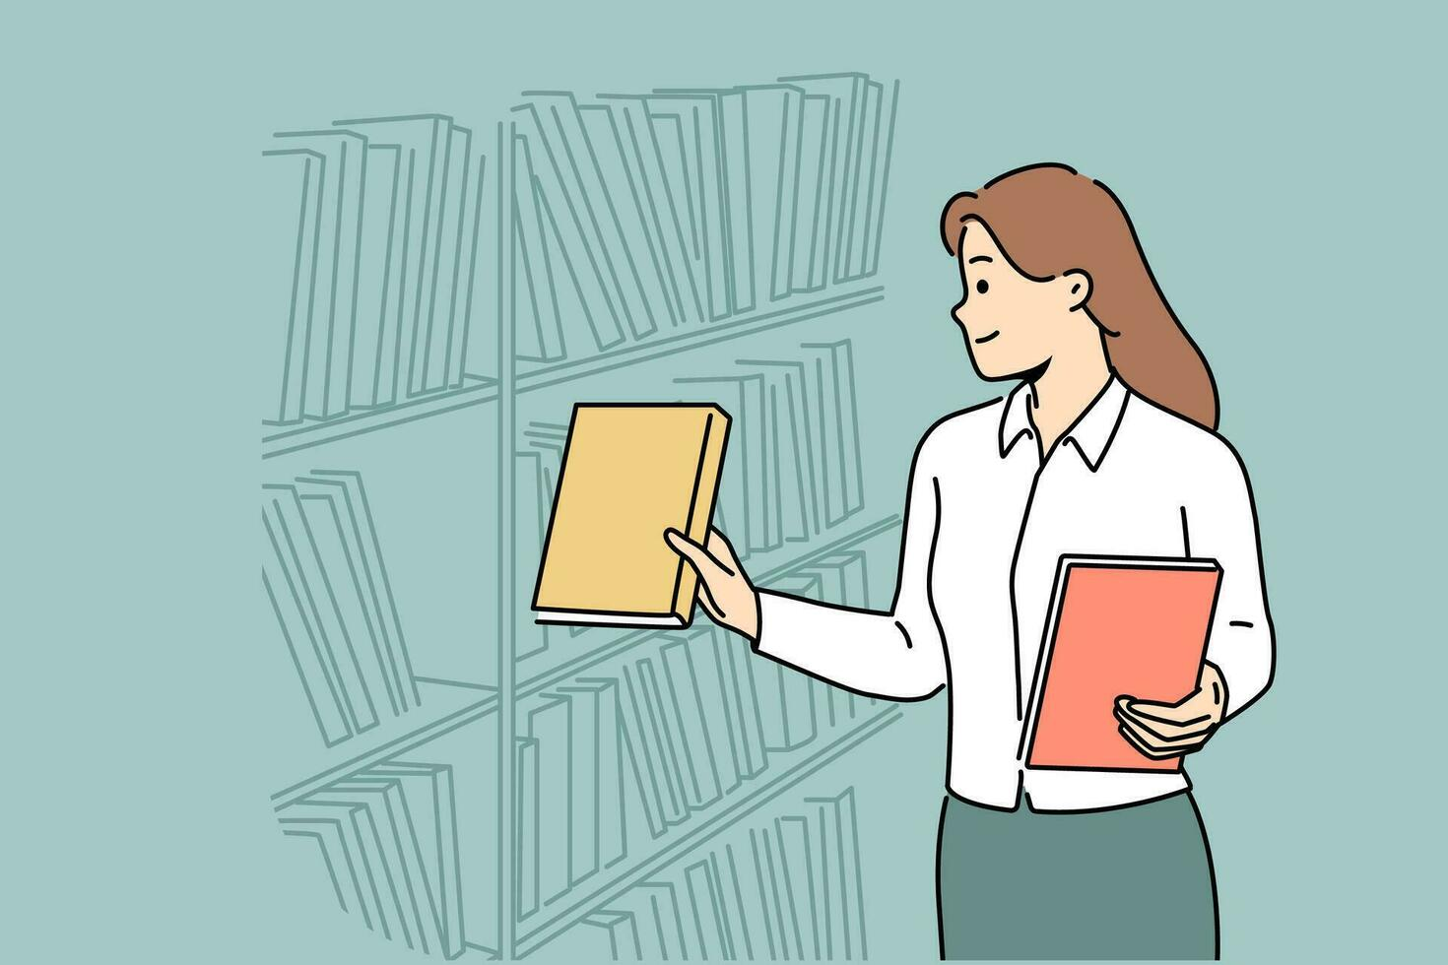
Discriminative AI

Slide 6
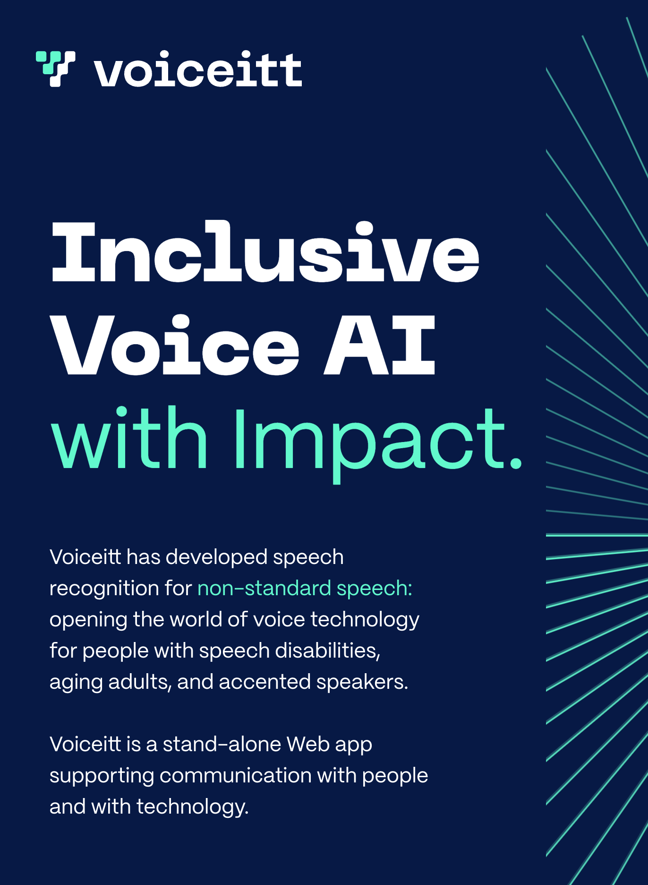
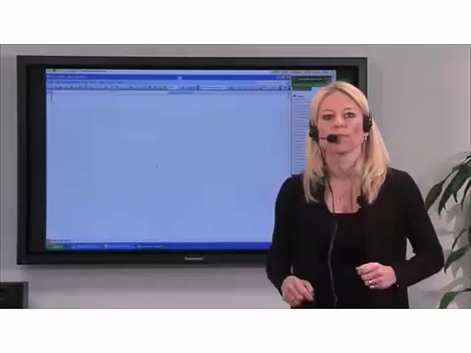
Speech recognition

Slide 7
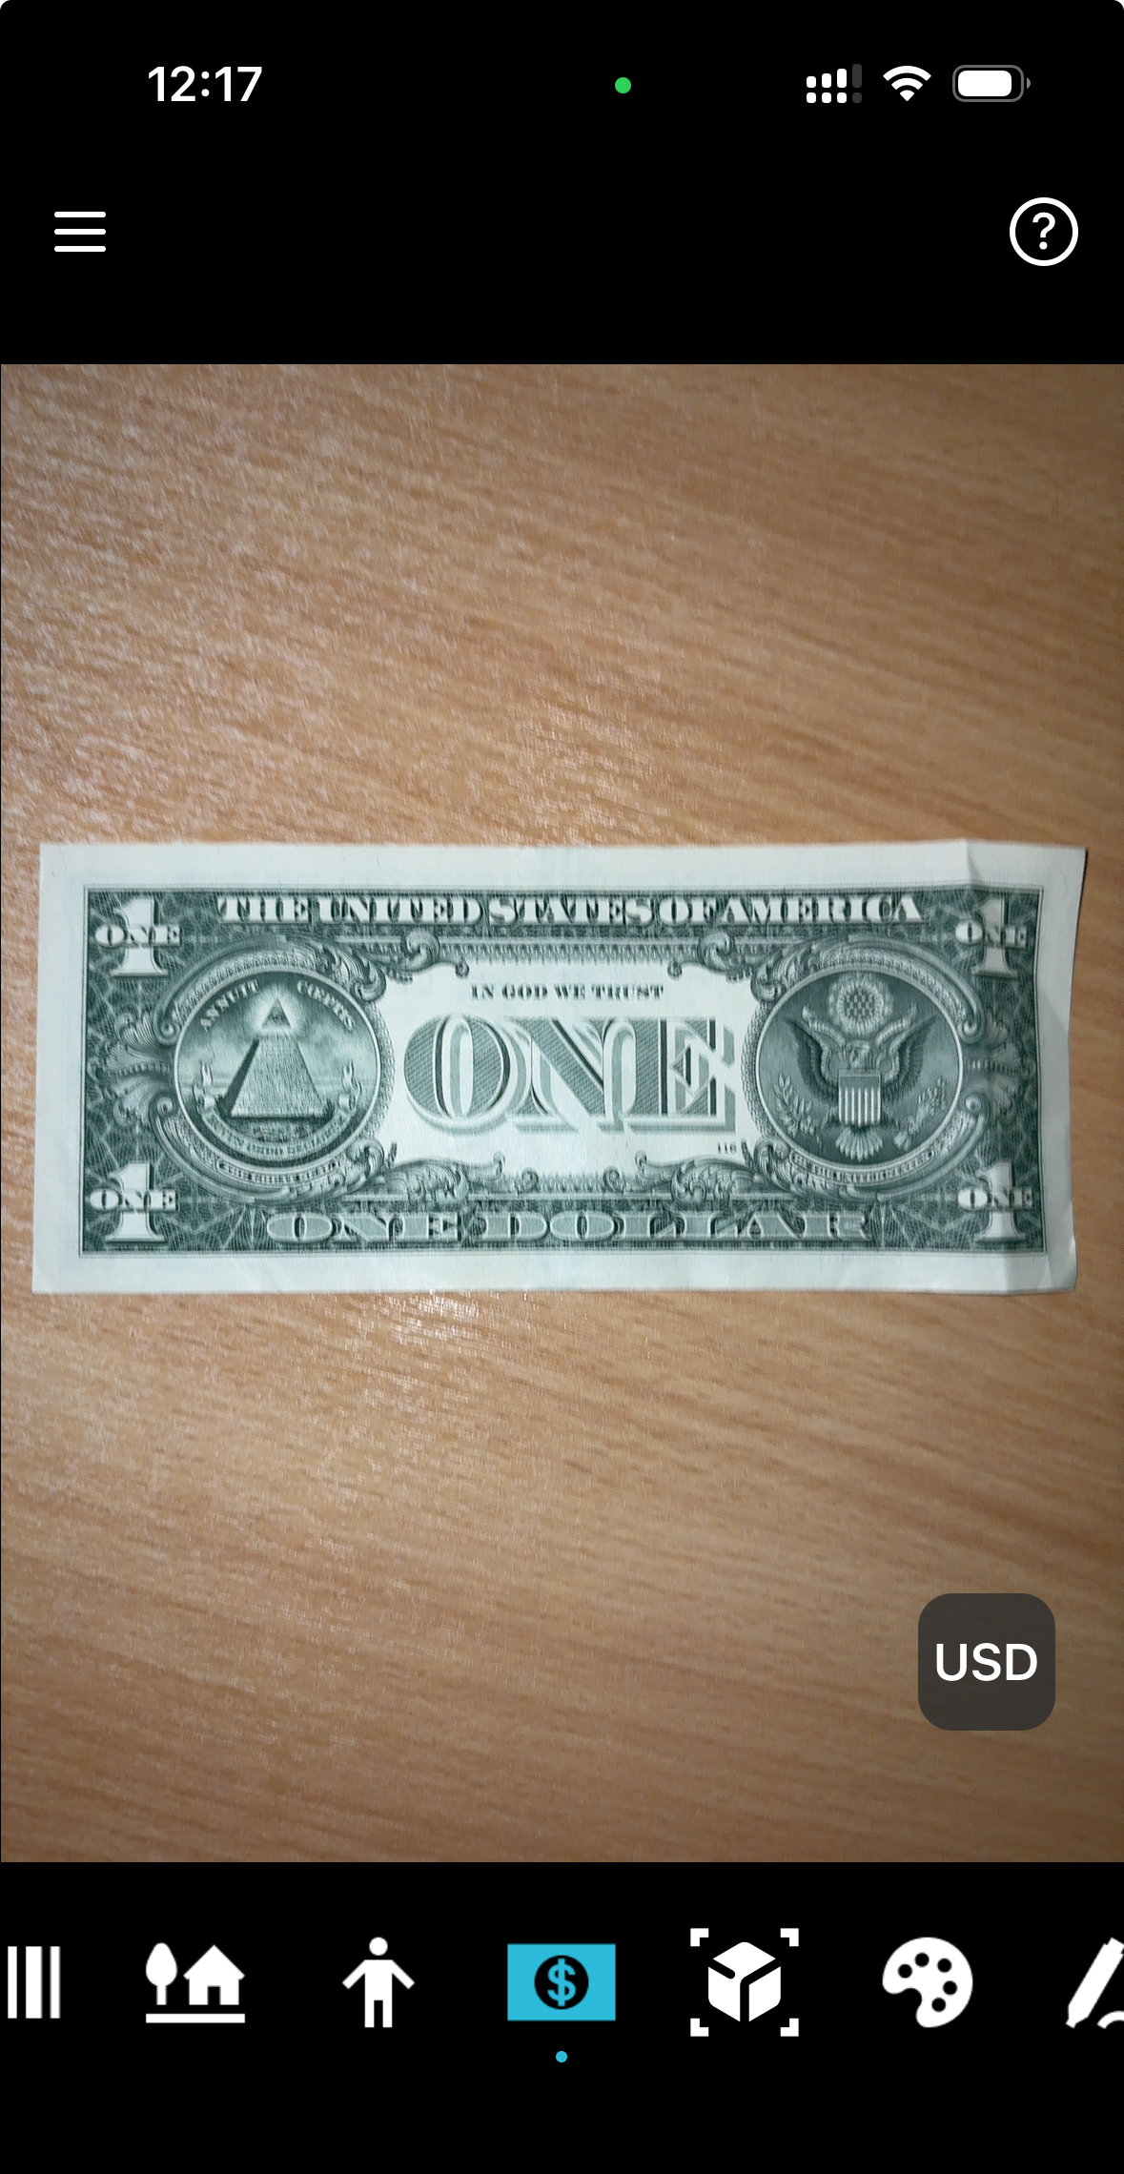
Object recognition

Slide 8

Face recognition

Slide 9
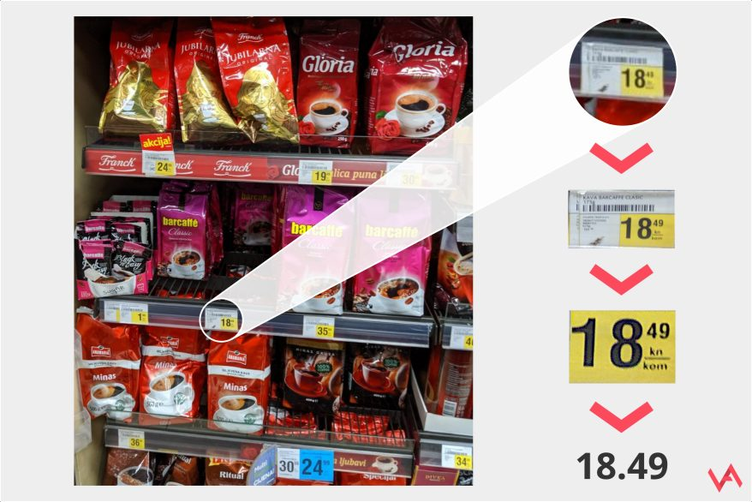
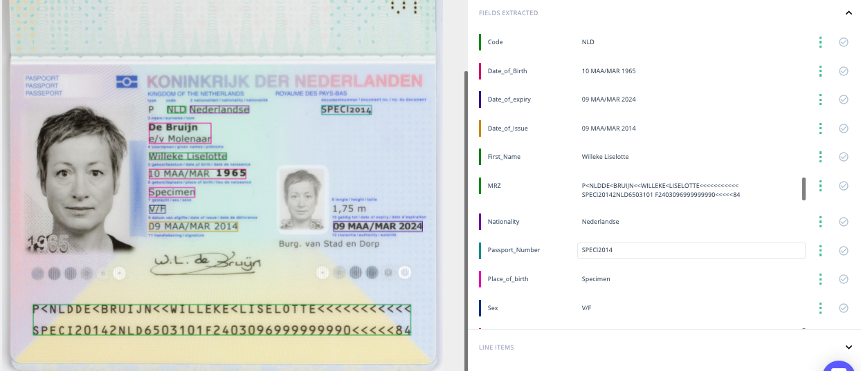
Character recognition

Slide 10
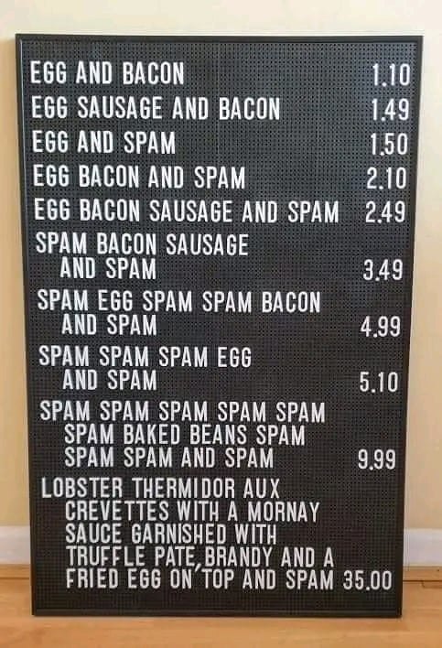
Pattern recognition

Slide 11
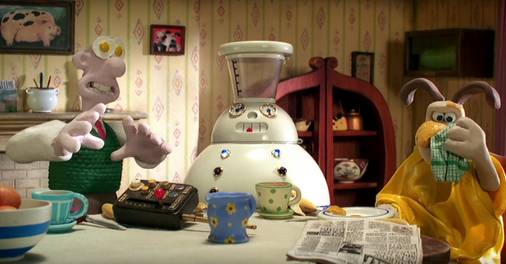
Generative AI

Slide 12
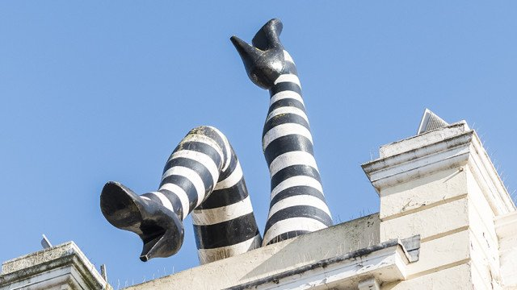
Text generation

Slide 13
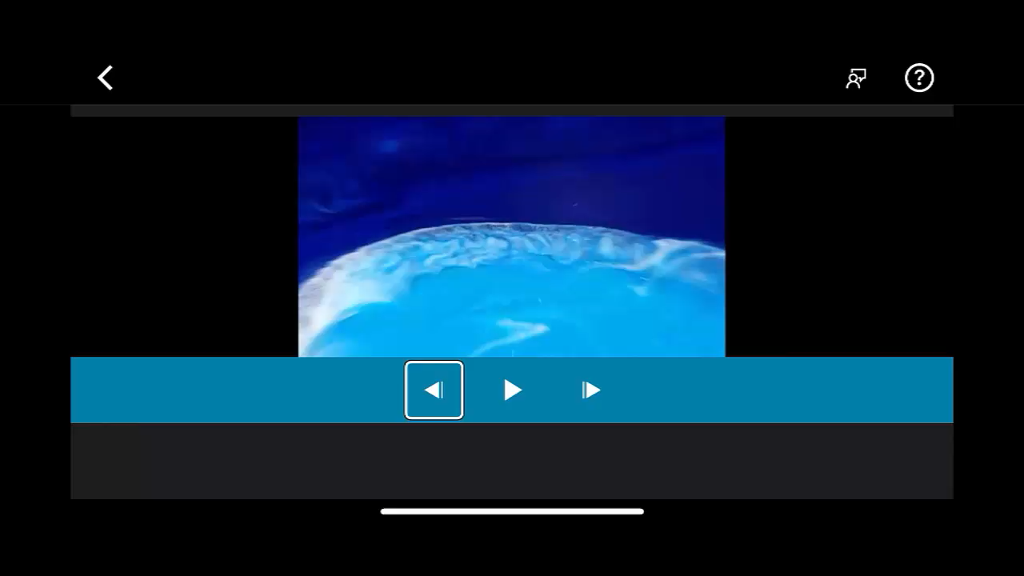
Video description

Slide 14
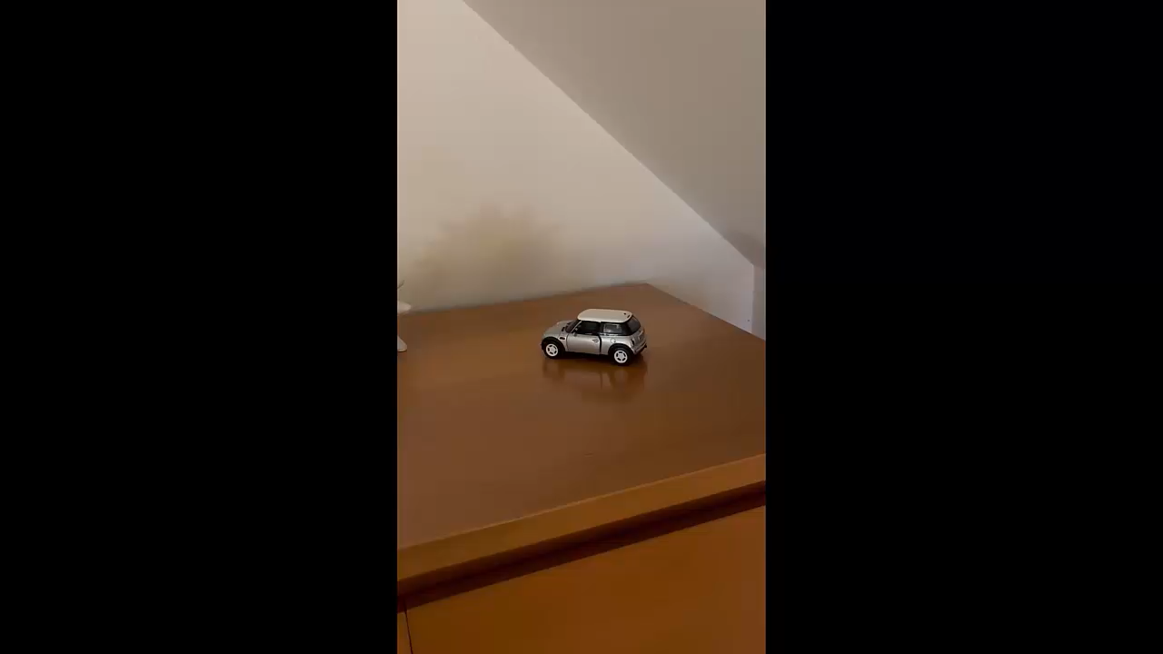
Realtime description
fantasai <fantasai@inkedblade.net>, board@w3.org

Slide 15
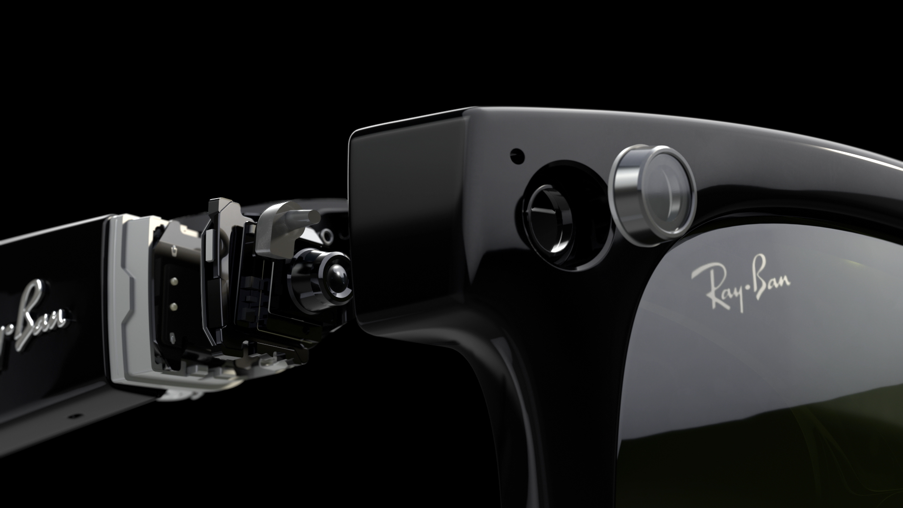
Wearable

Slide 16
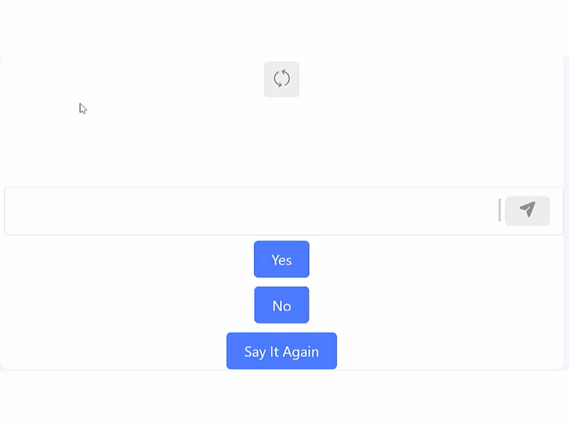
Text + speech generation
https://easyspeak-aac.com

Slide 17
Speech generation

Slide 18

Pattern recognition + speech generation

Slide 19
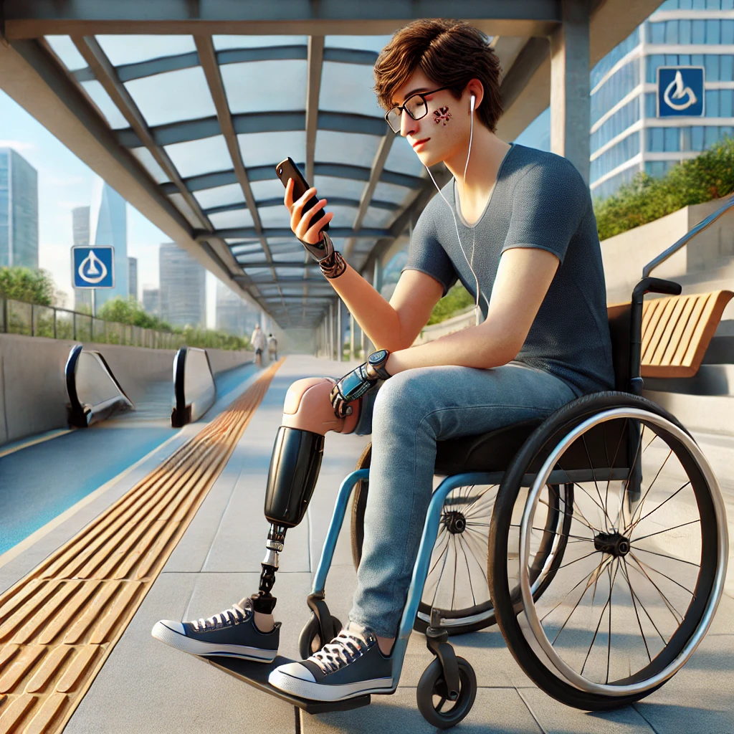
Image generation

Slide 20
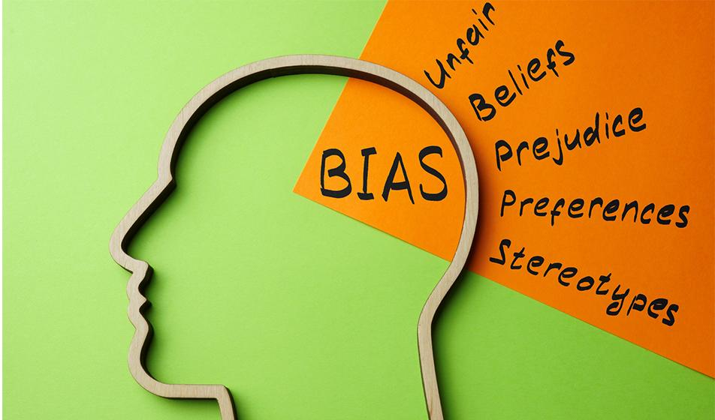
Bias

Slide 21
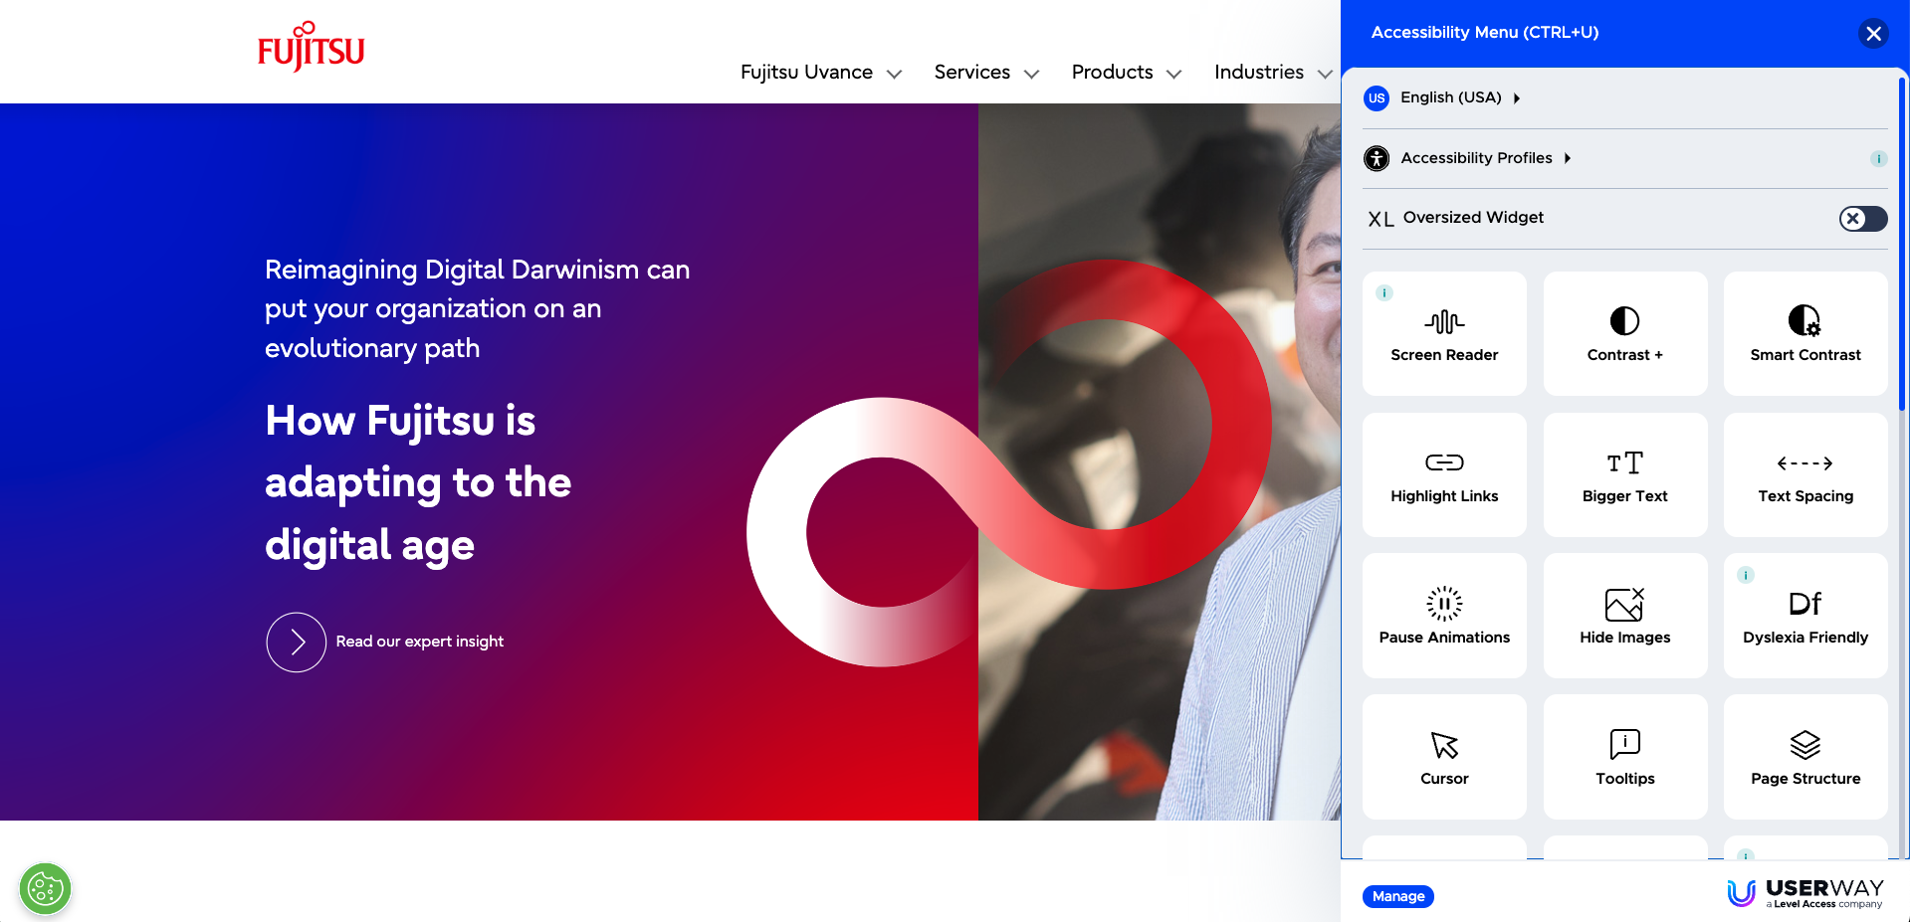
Overlays

Slide 22
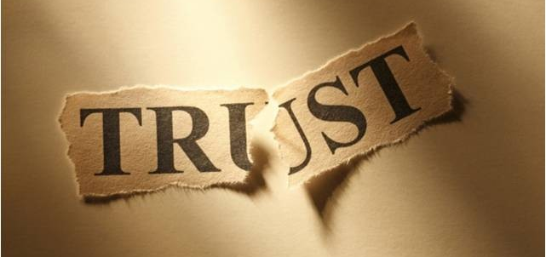
Promises

Slide 23
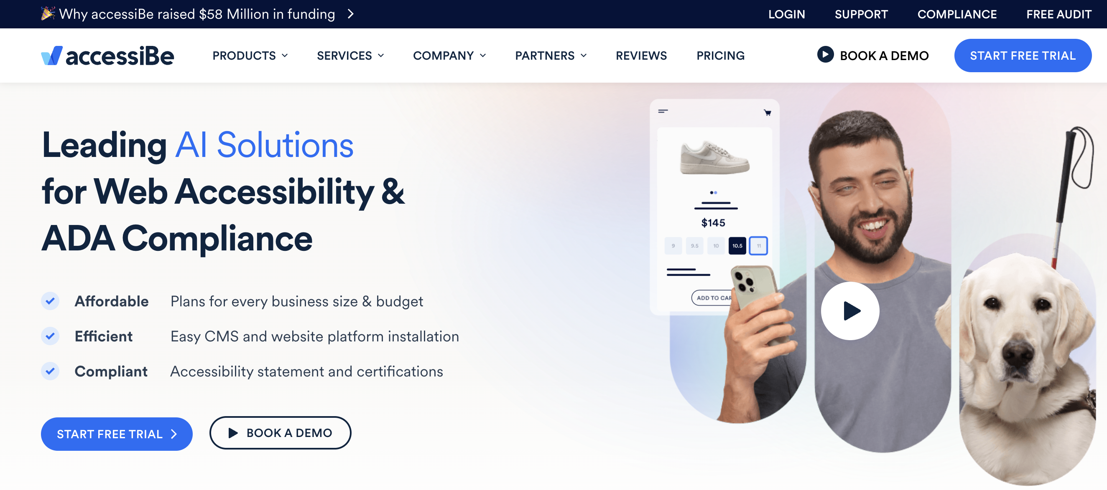




AccessiBe

Slide 24
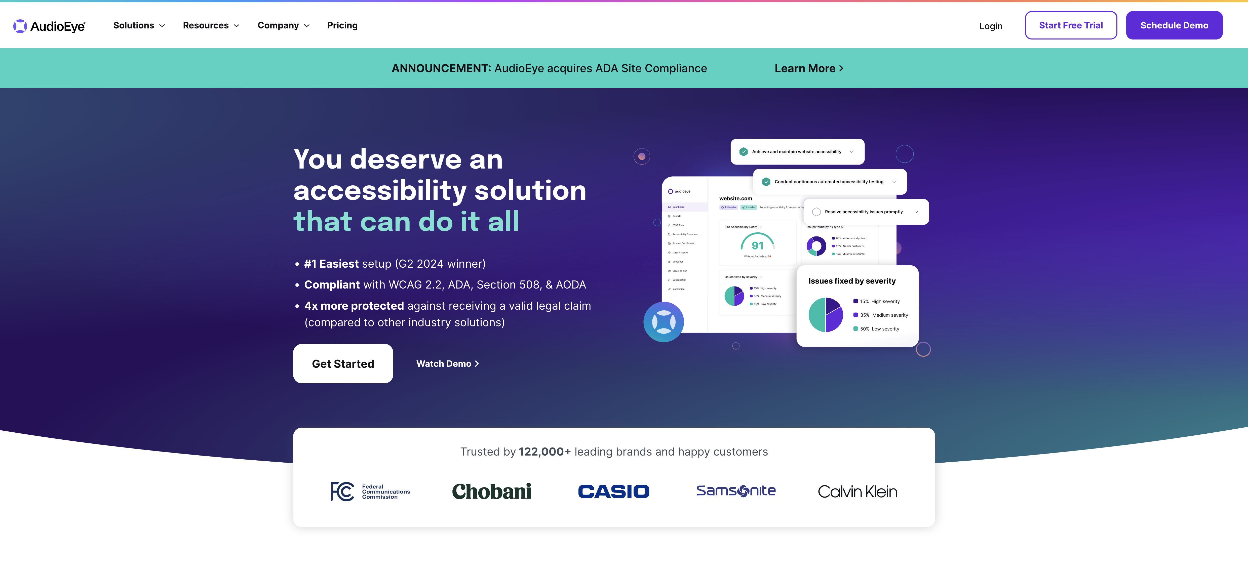
AudioEye

Slide 25
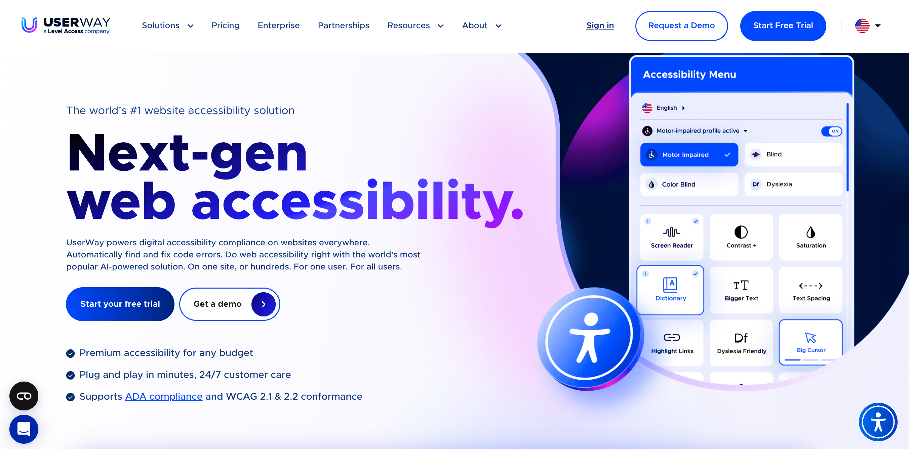
UserWay

Slide 26
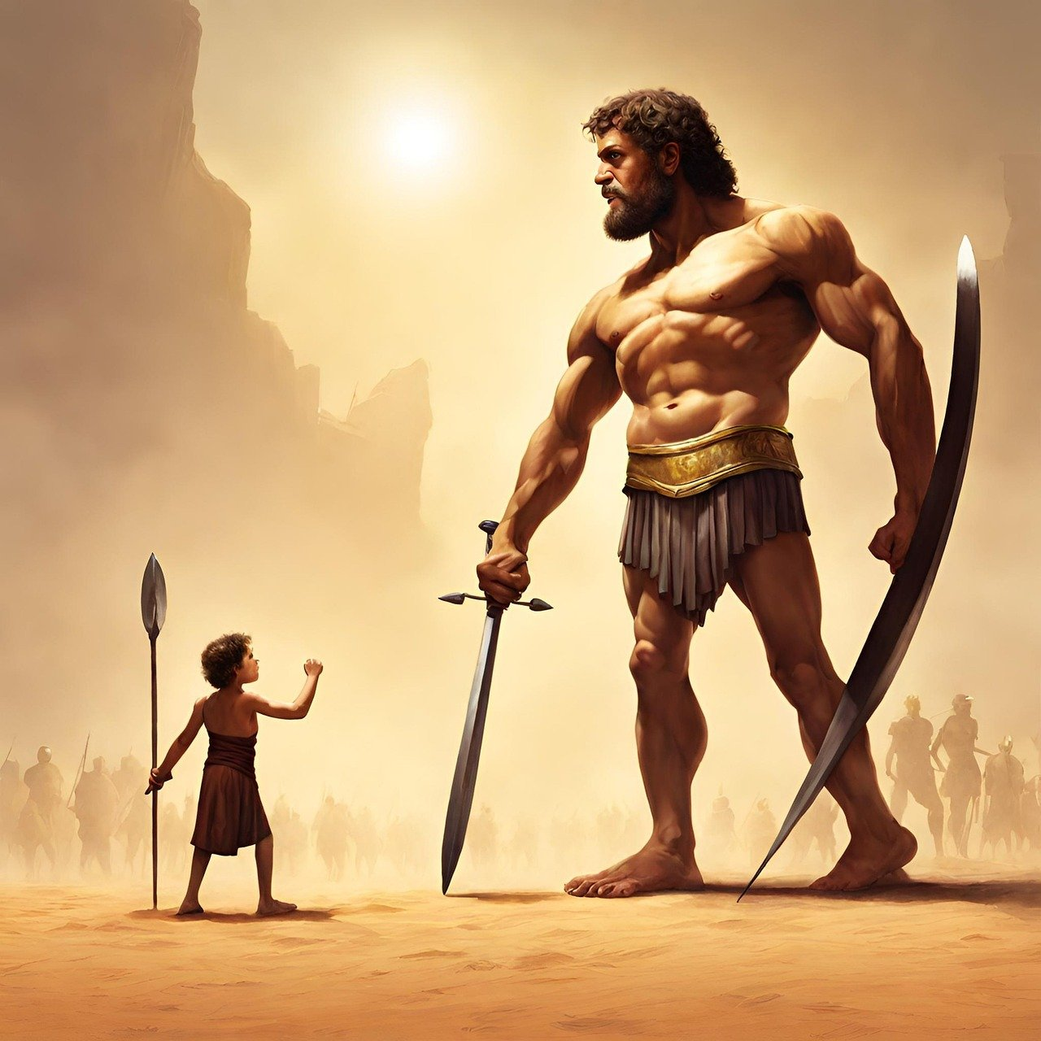
Tactics

Slide 27
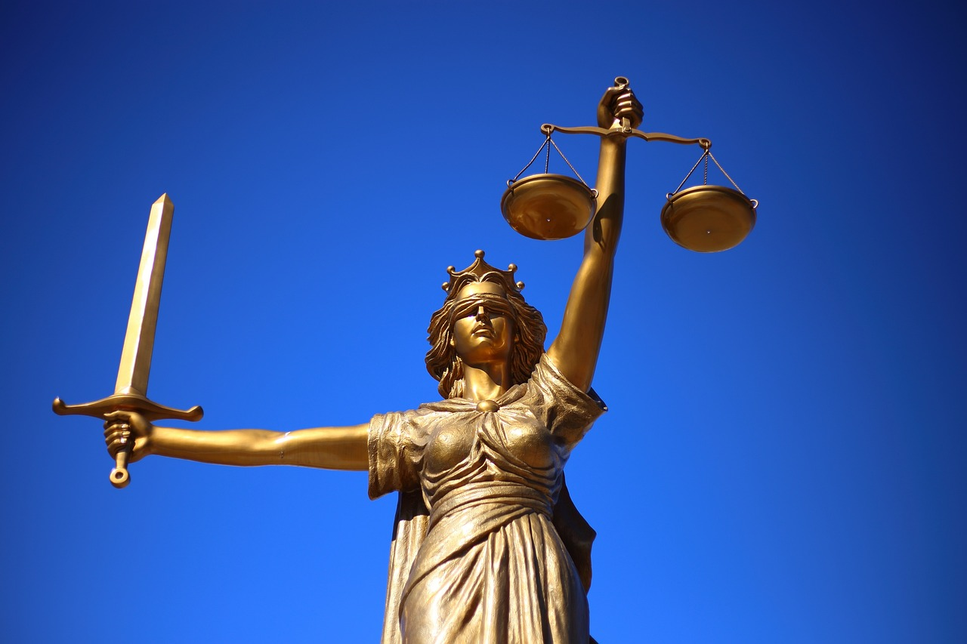
Results

Slide 28
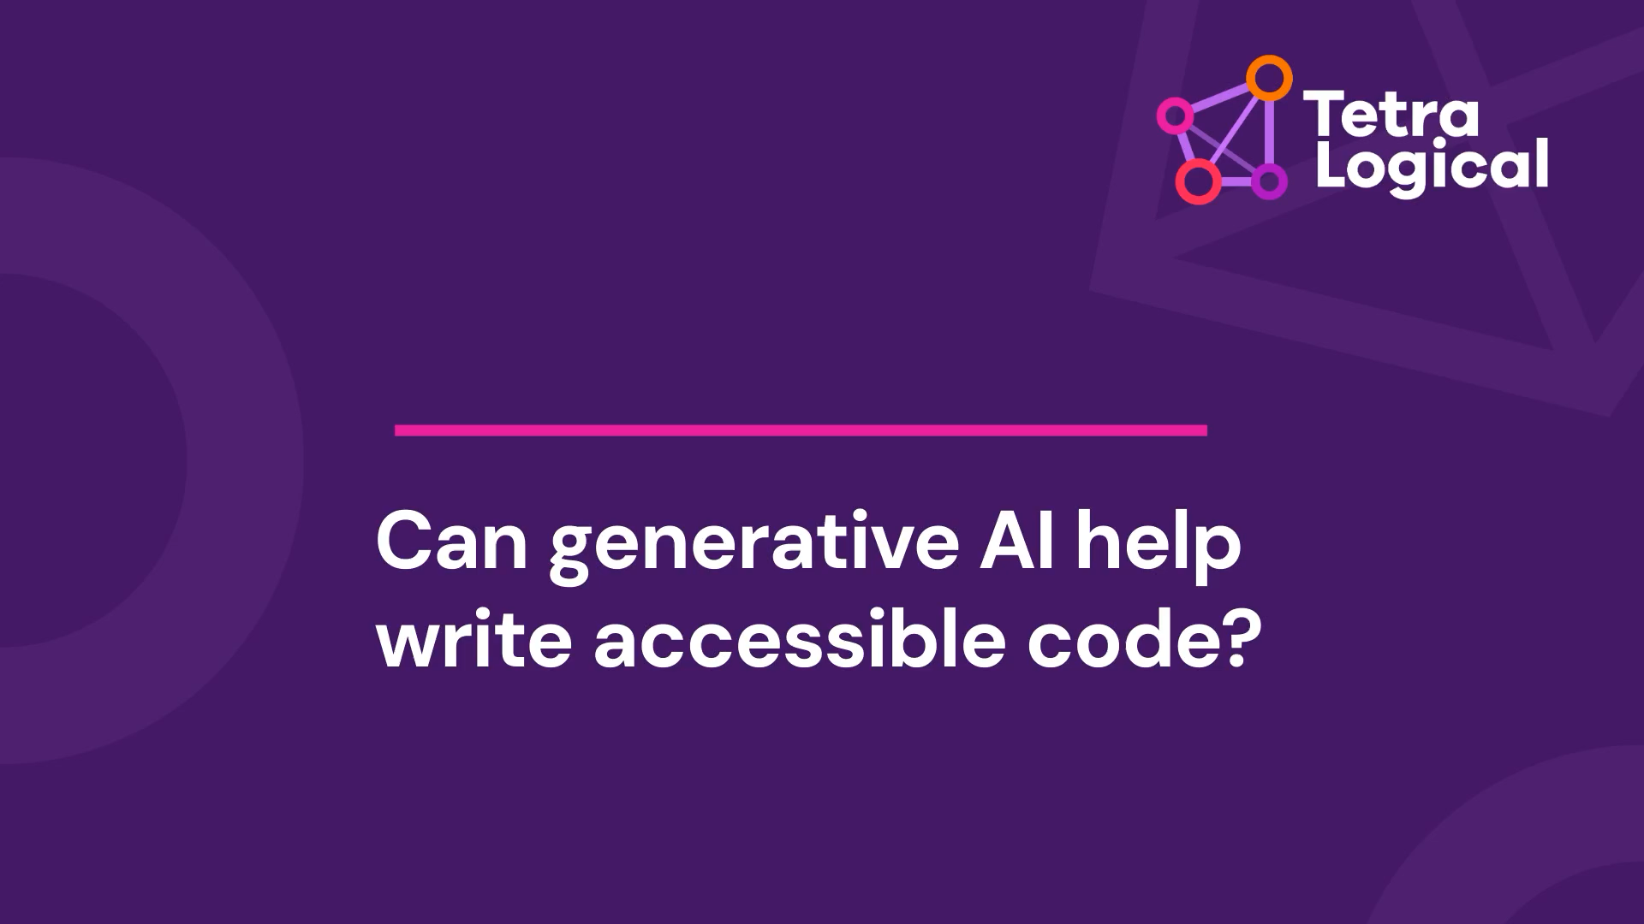
Code generation
*** Shortened blog post video ***

Slide 29
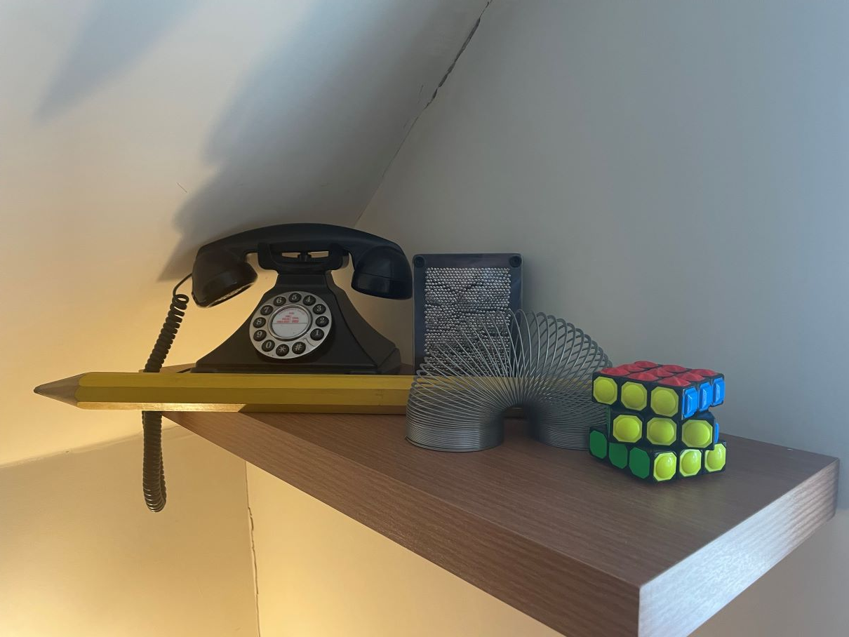
Hallucinations

Slide 30
Thank you

